Slide 1

GenAI Frameworks – LangChain and LangGraph
Bhanu Chander V
26th Nov 2024, 29th Nov 2024

Slide 2
Basic RAG Approach
Query
Upload and Process Document
Create Embeddings
Store Embeddings
Query Embeddings
Pass Context to LLM
Generate Response
Parse Info. & Chunking
PyPDF2,
docx, BeautifulSoup
OpenAIEmbeddings API
SentenceTransformers
FAISS
Pinecone
Chroma
top-k relevant chunks,
Similarity
Retrieve Chunks
Prompting
OpenAI API,
Open or closed source LLMs
Langchain can automate the above manual tasks for you
Majorly it can: Interact with External Data, make API Calls, use Memory etc.

Slide 3
Langchain Components
Ready available customizable templates
Doc. Loaders
Vector DBs
Retrievers
Prompts
Open-source or Close-source
Indexes
LLM
LangChain
Memory
Past interactions
Agents
Reasoning Engine,
Chains
Tools/Abstraction
Collection of Tools linked in an order
Prebuilt steps that can be chained together

Slide 4
LangChain Components
1. Tools:
Independent components that can be chained
Embeddings, vector stores, Loaders etc.
Interfaces that allow language models to interact with external systems, such as:
APIs
Databases
Functions etc.
Each Tool has:
Name
Description
Inputs
Function
Examples:
A Function that queries a DB
Call an external API
Initiate a document loader or embeddings

Slide 5
2. Chains:
Sequences of Tool calls (or actions): Allows you to combine multiple tools into a workflow.
Actions in chains are predefined and specified in a specific order
Linear and Static. They don’t change dynamically based on Input.
Examples:
Chain1: A chain for Data/Doc Processing Pipeline: Loading, Embedding, & Storing
Chain2: A chain to Query Handling: combine query embeddings + generate response int a chain
3. Agents:
Manage workflows – dynamically decide which Tool/Chain to use and in which order
Agents are responsible for:
Overall logic
Can dynamically adjust the workflow based on input & context
Examples:
An agent that uses a doc loader, embedding model, vectorstore, & lang model to handle user queries
An agent that process Chain2 after Chain1

Slide 6
LangChain Demo

Slide 7
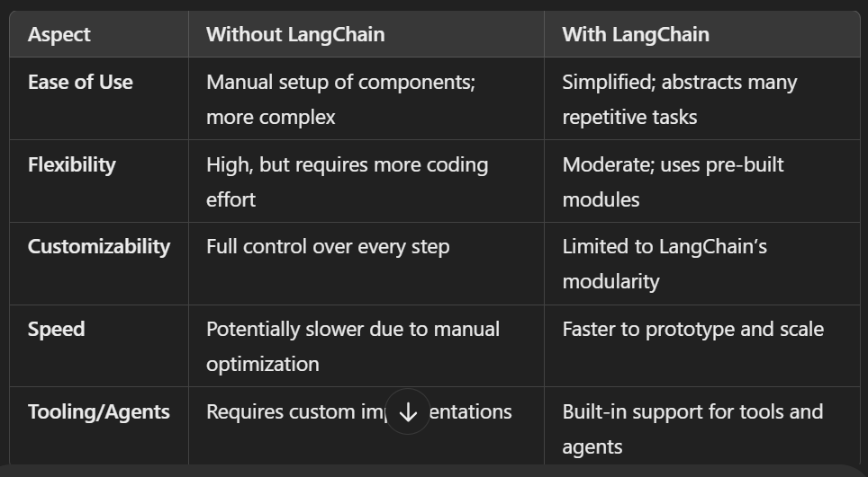
Pros & Cons (Langchain)

Slide 8
LangGraph
Built on top of LangChain to manage Agents and their workflows.
LangGraph can create Agents & Multi-agents workflows
Consider when app needs multi-agents interaction to solve complex problems
Edge
Action 1
Action 2
Edge
Start
Node 1
Node 2
End
State
Updated & Accessed by different parts of Graph
Edges:
Connect Nodes & define direction of data flow, flow of execution
Nodes:
Specific tasks, Individual Actions, like executing LLM, running functions etc.

Slide 9
LangGraph Demo

Slide 10
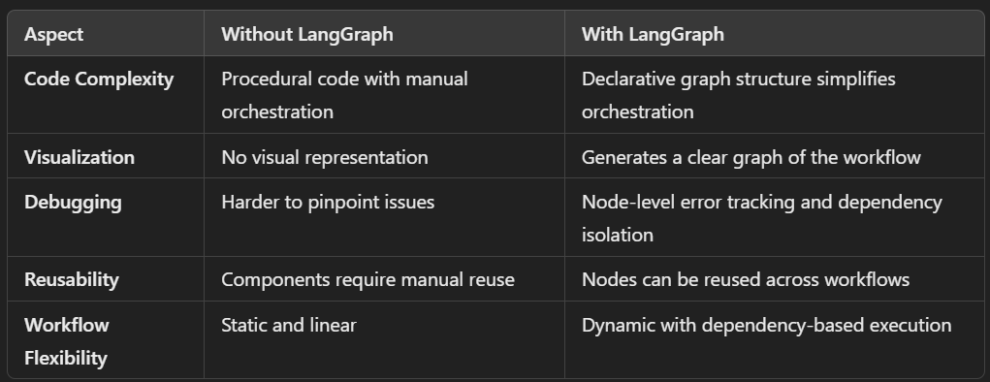
Pros of LangGraph

Slide 11
LangSmith
Can be used with any framework.
Monitoring & evaluation tool
Basically LLMOps - to monitor tokens used, cost, I/p, O/p, execution time etc.
If App is simple, LS can be overkill. Mostly use for Deploying & Testing
LangFlow
Drag & Drop, without code,
For LLM Prototyping - Not for production
Other Tools to explore:
RelevanceAI
Dify

Slide 12
https://python.langchain.com/docs/integrations/tools/
Tools Examples:
Function | Description | Tool
Retrieval | Retrieves documents or chunks based on semantic similarity to the query. | VectorstoreRetriever (e.g., FAISS, Pinecone, Chroma, Weaviate)
Embeddings | Tools to generate vector embeddings from text data. | OpenAIEmbeddings, HuggingFaceEmbeddings, CohereEmbeddings
Databases | Executes SQL queries to retrieve data from relational databases. | SQLDatabase
Web Search | Fetches real-time data from the web for context. | BingSearchAPI, GoogleSearchAPI
File I/O | Reads and writes local or cloud-stored files. | FileTool
Translation/Language | Performs translation for multilingual queries and contexts. | GoogleTranslate, DeepL
Utilities | Performs auxiliary tasks like calculations or JSON parsing. | Calculator, JSONExtractor, TextCleaner
LangChain Components Reference for https://python.langchain.com/docs/integrations/components/
– Models, Retrievers, Tools, Doc Loaders, VectorStores, Embedding models, others

Slide 13
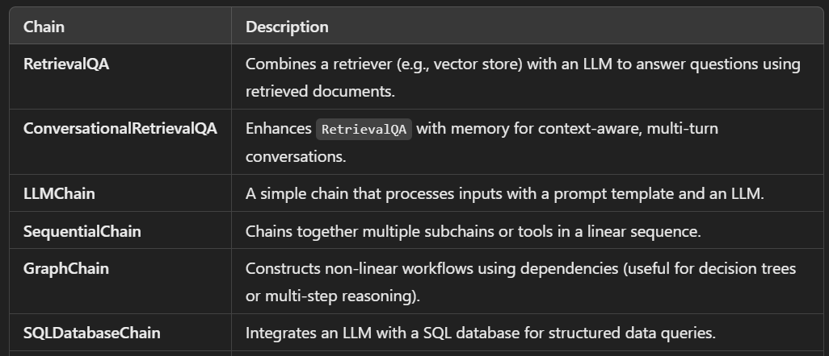
Chains Examples:

Slide 14
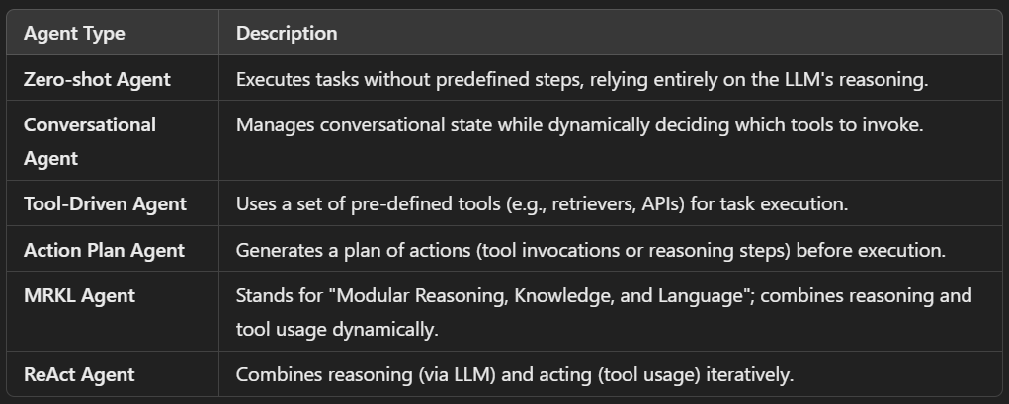
Agents Examples:

Slide 15
Sample Combinations of Tools, Chains & Agents
Single-turn QA
Tools: VectorstoreRetriever
Chains: RetrievalQA
Agents: Zero-shot Agent
Multi-turn Conversational QA
Tools: VectorstoreRetriever, ConversationalMemory
Chains: ConversationalRetrievalQA
Agents: Conversational Agent

Slide 16
Example usecase: RAG for Tables Info. Extraction
(Relevant Use cases: Transformers, Technical Bids etc.)
Basic Workflow:
Process an uploaded document
Retrieves a document (PDF or HTML) containing tables from a storage.
Dynamically selects a tool for table extraction (using Camelot/Tabula-py for grid-based tables, pdfplumber for irregular tables).
Extracts the relevant table.
Identifies the column with quantities (e.g., “Quantity”, “Price”).
Extracts numbers using a regex or NLP tool like spaCy to recognize quantities with units.
Sends this data to a database or generates a summary report.

Slide 17
LangGraph could be a good fit in the following scenarios:
Complex workflows: If the task involves multiple steps or a chain of operations,
e.g., you can combine table extraction, quantity recognition, and data manipulation in a single workflow.
Multiple data sources: need to create a unified workflow for extracting and processing the data from different formats
e.g., PDFs, word, HTML tables, databases)
Your workflow involves decision-making based on the type of table or content
e.g., a node that checks the format of a document and then routes the flow to the appropriate extraction tool
Combining different tools: LangGraph allows you to seamlessly integrate multiple tools
e.g., pdfplumber, Camelot, BeautifulSoup, regex, spaCy) into a cohesive pipeline.
If you are building a more extensible system that may need to scale in the future
e.g., adding more tools, changing the extraction logic, or implementing multiple steps

Slide 18
More?

Slide 19
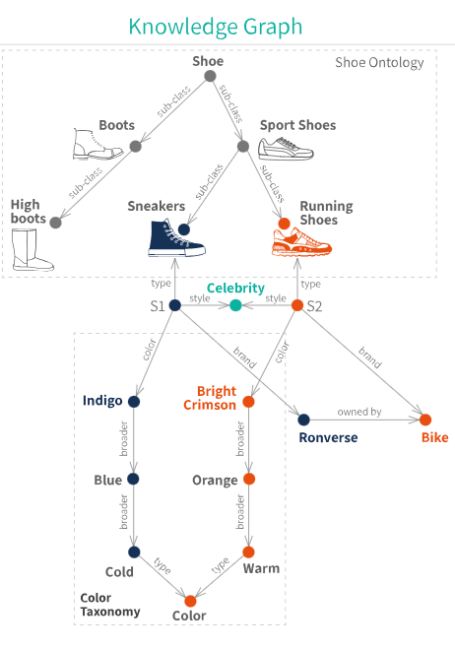
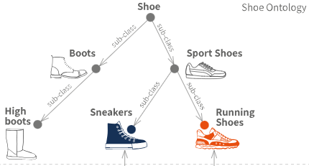
Knowledge Graph
Structured representation of information, where data is organized in the form of a graph
Consisting of
Nodes (entities or concepts) and
Edges (relationships or associations between nodes)
Designed to model, store, and organize complex information in a way that makes it easy for both humans and machines to understand, navigate, and use the knowledge it contains.

Slide 20
Example of Knowledge Graph for Hospital
Nodes Patient, Doctor, Medication, Treatment, Diagnosis
Edges
"Diagnosed with" (connecting Patient and Diagnosis),
"Prescribed" (connecting Doctor and Medication),
"Treated with" (connecting Patient and Treatment)
Entity Example: people, locations, organizations etc. (basically Nodes)
Diagnosed with
Patient
Disease
Treated by
Doctor
Treated with
Treatment
Prescribed
Medication

Slide 21
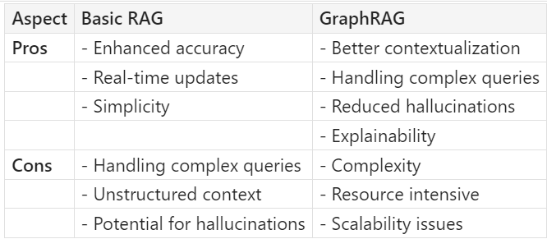
https://microsoft.github.io/graphrag/
GraphRAG
Graph-based Retrieval-Augmented Generation
Leverages knowledge graphs to enhance the capabilities of LLMs
Extracts structured data from unstructured text and organizes it into a knowledge graph
More Accurate and Contextually relevant answers – by connecting different pieces of Info.
Imagine an LLM looking at a graphical representation of a data – it will have a clear understanding of connectivity between information and therefore can answer more logically
Hence GraphRAG helps an LLM connect the dots
Step-by-Step Example of GraphRAG
Data Collection
Entity Extraction
Knowledge Graph Creation
Query Processing
Answer Generation

Slide 22
GraphRAG Examples
Contracts: Using GraphRAG, you can create a knowledge graph that maps entities like companies, individuals, dates, and legal terms from contract documents. The graph can help in quickly querying specific terms, identifying patterns, and suggesting amendments.
Procurement: Build a knowledge graph connecting suppliers, products, prices, and contract terms. GraphRAG can help identify the most reliable and cost-effective suppliers based on historical data and performance metrics.
Supply Chain Management: Create a knowledge graph mapping out suppliers, logistics, inventory levels, and sales data. Use GraphRAG to predict potential supply chain disruptions and suggest alternative routes or suppliers.
Engineering Document Comparison: Build a knowledge graph that captures the relationships between different components, materials, and specifications. Use GraphRAG to highlight changes and suggest optimizations based on historical data and best practices.
Table Information Extraction from Brochures: Extract tables from brochures, create a knowledge graph with the extracted data, and use GraphRAG to query specific information, like product specifications or pricing.

